Slide 1
EE 441 Data Structures
Lecture 10: Sorting

Slide 2
Sorting
We need to do sorting for the following reasons :
  By keeping a data file sorted, we can do binary search on it.
  Doing certain operations, like matching data in two different files, become much faster.
There are various methods for sorting, having different average and worst case behaviors

Slide 3
Selection sort algorithm
n data items are stored in Array A
Make n-1 passes over the list
On pass 0:
  select the smallest element in the list
  exchange it with A[0]
  Front of the list A[0] is ordered
  Tail of the list A[1] to A[n-1] is unordered
On pass 1:
  select the smallest element in the unordered tail list
  exchange it with A[1]
Continue until n-1 passes

Slide 4
Selection sort algorithm
On pass 0:
  select the smallest element in the list
  exchange it with A[0]
  Front of the list A[0] is ordered
  Tail of the list A[1] to A[n-1] is unordered
  Go on…
Example:
A=50,20,40,75,35
i=0: 20,50,40,75,35
i=1: 20,35,50,40,75
i=2: 20,35,40,50,75
i=3 : 20,35,40,50,75
i=4 : 20,35,40,50,75
Complexity?
Best case? Worst Case?

Slide 5
Selection sort algorithm complexity
Requires fixed number of comparisons that depend only on the size of the array not the distribution of the data
For general pass i sublist A[i+1] to A[n-1] is considered
number of comparisons for pass i: (n-1)- (i+1)=n-i-1
Total number of comparisons:
No best or worst case
Number of comparisons O(n²)

Slide 6
Selection sort algorithm
// sort A[0]..A[n-2], and A[n-1] is in place
for (i = 0; i < n-1; i++)
{
// start the scan at index i; set smallIndex to i
smallIndex = i;
// j scans the sublist A[i+1]..A[n-1]
for (j = i+1; j < n; j++)
// update smallIndex if smaller element is found
if (A[j] < A[smallIndex])
smallIndex = j;
// when finished, place smallest item in A[i]
Swap(A[i], A[smallIndex]);
}
}
template <class T>
void Swap (T &x, T &y)
{
T temp;
temp = x;
x = y;
y = temp;
}
// sort an array of n elements of type T using the
// selection sort algorithm
template <class T>
void SelectionSort(T A[], int n)
{
// index of smallest item in each pass
int smallIndex;
int i, j;

Slide 7
Radix Sort
Let's have the following 4-bit binary numbers. Assume there is no sign bit.
  1010, (10)
  0101, (5)
  1011, (3)
  0011, (11)
  0110, (6)
  0111 ,(7)
First begin with the LSB (least significant bit). Make two groups, one with all numbers that end in a "0" and the other with all numbers that end in a "1".
  0:1010,0110
  1:0101,1011,0011,0111
  List after pass 1: 1010,0110 ,0101,1011,0011,0111

Slide 8
Radix Sort
Now, go to the next less SB and by examining the previous groups in order, form two new groups:
  1010,0110 ,0101,1011,0011,0111
  0:0101
  1: 1010,0110,1011,0011,0111
  List After pass2 :0101,1010,0110,1011,0011,0111

Slide 9
Radix Sort
Repeat the operation for the third bit from the right:
0:1010,1011,0011
1:0101,0110,0111
List after 3rd Pass:1010,1011,0011,0101,0110,0111
MSB:Pass:
0:0011,0101,0110,0111
1:1010,1011
Sorted List:0011,0101,0110,0111, 1010,1011
3,5,6,7,10,11
Complexity?
Best case? Worst Case?

Slide 10
Radix Sort: complexity
Each pass performs O(n) operations
For m digits: O(mn)
Disadvantage: Space use
For each digit it needs a separate queue
For practical purposes it cannot outperform O(nlogn) algorithms

Slide 11
Bubblesort
Array A with n elements
n-1 passes
Each pass we compare the adjacent elements
If first>second we exchange the elements
At the end of each pass: the largest element bubbles up to the top of the current list
After pass 0 is complete: the tail of the list A[n-1] is ordered and the front of the list remains unordered
We keep track of the index of the last exchanged element

Slide 12
Bubblesort
Example:
A=50,20,40,75,35
Pass 0:
  Exchange 50,20
  A=20,50,40,75,35
  Exchange 50,40
  A=20,40,50,75,35
  Ordered: 50,75
  Exchange 75,35
  A=20,40,50,35,75
  75 is the largest element: lastChangeIndex=3
  lastChangeIndex is not 0 continue
Pass1:Scan the sublist A[0] to A[lastChangeIndex]=A[3]
  Ordered: 20,40
  Ordered: 40,50
  Exchange 50,35
  A=20,40,35,50,75
  50 is the largest element: lastChangeIndex=2
  lastChangeIndex is not 0 continue

Slide 13
Bubblesort
Pass2:Scan the sublist A[0] to A[lastChangeIndex]=A[2]
  Ordered: 20,40
  Exchange 40,35
  A=20,35,40,50,75
  40 is the largest element: lastChangeIndex=1
  lastChangeIndex is not 0 continue
Pass3:Scan the sublist A[0] to A[lastChangeIndex]=A[1]
  Ordered: 20.35
  lastChangeIndex is 0 terminate
Complexity?
Best case? Worst Case?

Slide 14
Complexity of bubblesort
Best Case:
  Bubblesort makes a single pass over a sorted list
  Complexity is O(n)
Worst case:
  Reverse ordered list
  Makes n-1 passes
  On pass i n-1-i comparisons and exchanges
  Total: n(n-1)/2
  O(n²)

Slide 15
BubbleSort Algorithm
// BubbleSort is passed an array A and list count n. it
// sorts the data by making a series of passes as long as
// lastExchangeIndex > 0.
template <class T>
void BubbleSort(T A[], int n)
{
int i,j;
// Index of last exchange
int lastExchangeIndex;
// i is the index of last element in the sublist
i = n-1;
// continue the process until no exchanges are made
while (i > 0)
{
// start lastExchangeIndex at 0
lastExchangeIndex = 0;
// scan the sublist A[0] to A[i]
for (j = 0; j < i; j++)
// exchange a pair and update lastExchangeIndex
if (A[j+1] < A[j])
{
Swap(A[j],A[j+1]);
lastExchangeIndex = j;
}
// set i to index of the last exchange. continue sorting
// the sublist A[0] to A[i]
i = lastExchangeIndex;
}
}

Slide 16
Quick sort algorithm
Fastest know sorting algorithm
Partition approach to sort a list
Main Idea:
  Determine a pivot value to split the list into two parts
  Split the list into two parts according to the pivot
  Items smaller than the pivot goes into left list
  Items larger than the pivot goes into left list
  For each part and repeat the same procedure

Slide 17
Quick sort algorithm: Example
A=800,150,300,600,550,650,400,350,450,700
Scanning phase:
we scan the entire list A[0] to A[9]
Middle index mid=4
The pivot: A[mid]=550
2 sublists : Sl ≤pivot, Sh >pivot
Move pivot to the head of Sl we already know it will end up in Sl: Exchange A[0](A[low]) and A[mid]
A=550,150,300,600,800,650,400,350,450,700

Slide 18
Quick sort algorithm: Implementation
Two variables: ScanUp, ScanDown
ScanUp:
  responsible for locating the elements in sublist Sl
  Initially: set at low+1=1
ScanDown:
  responsible for locating the elements in sublist Sh
  Initially: set at high=9
Each pass identifies the elements in each of the sublists

Slide 19
Quick sort algorithm: Implementation Example
Each pass identifies the elements in each of the sublists
ScanUp searches the lower list. It moves up to look for A[scanup]>pivot
ScanDown searches the upper list. It moves down to lookfor A[scandown] ≤ pivot
Those two elements are in wrong sublists so exchange them: Swap(A[scanup],A[scandown])
Continue until ScanUp and ScanDown pass each other
Example: Scan Phase: Pivot:550
550,150,300,600,800,650,400,350,450,700
  ScanUp=600:A[3]
  ScanDown=450:A[8]
  550,150,300,600,800,650,400,350,450,700 ➔Swap
  After Swap: 550,150,300,450,800,650,400,350,600,700

Slide 20
Quick sort algorithm: Implementation Example
Scan: 550,150,300,450,800,650,400,350,600,700
  ScanUp=800:A[4]
  ScanDown=350:A[7] ➔ Swap
Scan: 550,150,300,450,350,650,400,800,600,700
  ScanUp=650:A[5]
  ScanDown=400:A[6] ➔ Swap
Scan:550,150,300,450,350,400,650,800,600,700
  ScanUp and ScanDown pass eachother at ScanUp=A[6] ScanDown=A[5]➔ they enter into the list they belong
ScanDown separates the list
Put Pivot back in place: Exchange A[0] and A[ScanDown]
Resulting list:400,150,300,450,350,550,650,800,600,700
Sl=A[0]-A[4], Sh=A[6]-A[9]

Slide 21
Quick sort algorithm: Example
Recursive phase:
  Sl:400,150,300,450,350
  Sh: 650,800,600,700
Sl: low=0, high=4, mid=2 pivot: A[mid]=2=300
  300,150,400,450,350
  ScanUp=400:A[2]
  ScanDown=150:A[1]
  Halt the process
  Exchange pivot and ScanDown
  150,300,400,450,350
  Stop processing Sl because it is single element

Slide 22
Quick sort algorithm
Partition a list A[low] to A[high] about a pivot at the middle of the list
mid = (low + high)/2;
pivot = A[mid];
Exchange pivot with A[low] set Scanup=low+1 ScanDown=high:
// exchange the pivot and the low end of the range
// and initialize the indices scanUp and scanDown.
Swap(A[mid], A[low]);
scanUp = low + 1;
scanDown = high;
Scanup:
// move up lower sublist; stop when scanUp enters
// upper sublist or identifies an element > pivot
while (scanUp <= scanDown && A[scanUp] <= pivot)
scanUp++;

Slide 23
Quick sort algorithm
After ScanUp is positioned ScanDown moves down the list:
/ scan down upper sublist; stop when scanDown locates
// an element <= pivot; we guarantee we stop at A[low]
while (pivot < A[scanDown])
scanDown--;
Conclusion of this loop: if ScanUp<ScanDown the vertices identify two elements that are in the wrong sublist exchange the values
/ if indices are still in their sublists, then they
// identify two elements in wrong sublists. exchange
if (scanUp < scanDown)
Swap(A[scanUp], A[scanDown]);

Slide 24
Quick sort algorithm
At this point, scanDown identifies the top of the left sublist that contains elements less than or equal to the pivot.
Index of ScanDown is the pivot location
Retrieve the pivot from A[low] and swap:
// copy pivot to index (scanDown) that partitions sublists
A[low] = A[scanDown];
A[scanDown] = pivot;

Slide 25
Quick sort algorithm
Use recursion to process the sublists:
locate the pivot to split the list
Recursive part Call with parameters: low to mid-1 and mid+1 to high
Stopping condition: when a sublist has 0 or 1 element (an ordered list)

Slide 26
Complexity: Quick sort algorithm
  Assumption: n=2k, k=log2n
Average case/Best Case:
Pivot lies in the middle of the list so sub-lists are of equal size
  First scan:
    n-1 comparisons (from two sides of the list)
    Sublists have size n/2
  Second scan:
    Each sublist have n/2 comparison: total comparison=2*n/2=n
  Eventually the splitting terminates after k passes, each pass with n comparisons
Average O(nlogn)

Slide 27
Complexity: Quick sort algorithm
Worst case:
pivot always falls in a one-element sublist
  Leaves the rest in the second sub-list
  Pivot is always the smallest element in the sub-list
  First scan: 1,n-1
  Second scan:2, n-2
  Comparisons n+n-1+n-2+…+2=n(n+1)/2
O(n²)

Slide 28
Sorting
 | Average | Worst
Bubble sort | O(n²) | O(n²)
Quick sort | O(nlogn) | O(n²)
Heap sort | O(nlogn)

Slide 29
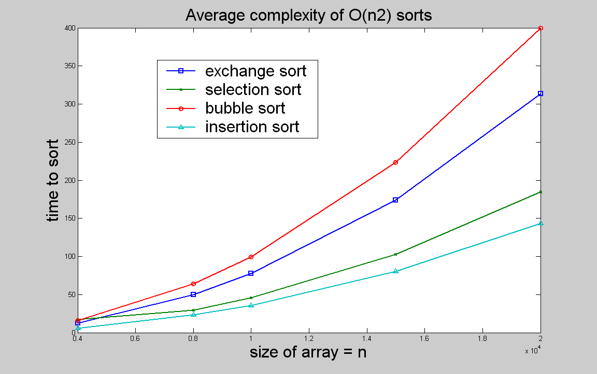
Comparison of algorithms
n | 4000 | 8000 | 10000 | 15000 | 20000
exchange sort | 12.23 | 49.95 | 77.47 | 173.97 | 313.33
selection sort | 17.3 | 29.43 | 46.02 | 103 | 185.05
bubble sort | 15.78 | 64.03 | 99.1 | 223.28 | 399.47
insertion sort | 5.67 | 23.15 | 35.43 | 80.23 | 143.67
quick sort | 0.07 | 0.17 | 0.22 | 0.33 | 0.47

Slide 30
EE 441 Data Structures
Lecture 10: Sorting

